Slide 2
Binghamton University
EngiNet™
State University of New York

Slide 3
Thomas J. Watson
School of Engineering and Applied Science

Slide 4
WARNING
All rights reserved. No part of the course materials used in the instruction of this course may be reproduced in any form or by any electronic or mechanical means, including the use of information storage and retrieval systems, without written approval from the copyright owner.
©2017 International Business Machines and Binghamton University

Slide 5
CS480Z/CS580Z
(Fall, 2017)
(Tuesday’s and Thursday’s 11:40 to 1:05)
Introduction to the Mainframe: z/VM Basics
Lecture 6
September 12, 2017
Faculty : Patty Rando, Merwyn Jones
IBM z/VM Lab Development team
( http://www.vm.ibm.com/ )

Slide 6
CMS Basics
Patty Rando
Melissa Howland
z/VM Development
Endicott, NY

Slide 7
Trademarks
The following are trademarks of the International Business Machines Corporation in the United States and/or other countries.
CICS*
DB2*
DB2 Connect
DB2 Universal Database
DFSMS/MVS*
DFSMS/VM*
e-business logo*
Enterprise Storage Server
ESCON
FICON
GDDM
HiperSockets
IBM*
IBM logo
Language Environment*
MQSeries*
Multiprise*
MVS
NetRexx
OpenEdition*
OpenExtensions
OS/390*
Parallel Sysplex*
PR/SM
QMF
RACF*
RAMAC*
RISC
S/370
S/370
S/390*
S/390 Parallel Enterprise Server
Virtual Image Facility
VisualAge*
VisualGen*
VM/ESA*
VTAM*
VSE/ESA
WebSphere
z/Architecture
z/OS
zSeries
z/VM*
* Registered trademarks of the IBM Corporation
The following are trademarks or registered trademarks of other companies.
Lotus, Notes, and Domino are trademarks or registered trademarks of Lotus Development Corporation.
Tivoli is a trademark of Tivoli Systems Inc.
Java and all Java-related trademarks and logos are trademarks of Sun Microsystems, Inc., in the United States and other countries
UNIX is a registered trademark of The Open Group in the United States and other countries.
Microsoft, Windows and Windows NT are registered trademarks of Microsoft Corporation.
Notes:
Performance is in Internal Throughput Rate (ITR) ratio based on measurements and projections using standard IBM benchmarks in a controlled environment. The actual throughput that any
user will experience will vary depending upon considerations such as the amount of multiprogramming in the user's job stream, the I/O configuration, the storage configuration, and the
workload processed. Therefore, no assurance can be given that an individual user will achieve throughput improvements equivalent to the performance ratios stated here.
IBM hardware products are manufactured from new parts, or new and serviceable used parts. Regardless, our warranty terms apply.
All customer examples cited or described in this presentation are presented as illustrations of the manner in which some customers have used IBM products and the results they may have
achieved. Actual environmental costs and performance characteristics will vary depending on individual customer configurations and conditions.
This publication was produced in the United States. IBM may not offer the products, services or features discussed in this document in other countries, and the information may be subject
to change without notice. Consult your local IBM business contact for information on the product or services available in your area.
IBM considers a product “Year 2000 ready” if the product, when used in accordance with its associated documentation, is capable of correctly processing, providing and/or receiving date
data within and between the 20th and 21st centuries, provided that all products (for example, hardware, software and firmware) used with the product properly exchange accurate date data
with it. Any statements concerning the Year 2000 readiness of any IBM products contained in this presentation are Year 2000 Readiness Disclosures, subject to the Year 2000 Information
and Readiness Disclosure Act of 1998.
All statements regarding IBM's future direction and intent are subject to change or withdrawal without notice, and represent goals and objectives only.
Information about non-IBM products is obtained from the manufacturers of those products or their published announcements. IBM has not tested those products and cannot confirm the
performance, compatibility, or any other claims related to non-IBM products. Questions on the capabilities of non-IBM products should be addressed to the suppliers of those products.

Slide 8
Disclaimer
The information contained in this document is not intended to be an assertion of future action by IBM. The use of this information or the implementation of any of these techniques is a customer responsibility and depends on the customer's ability to evaluate and integrate them into the operational environment. While each item may have been reviewed by IBM for accuracy in a specific situation, there is no guarantee that the same or similar results will be obtained elsewhere. Customers attempting to adopt these techniques to their own environment do so at their own risk.
In this presentation, any references made to an IBM licensed program are not intended to state or imply that only IBM's licensed program may be used; any functionally equivalent program may be used instead.
Any performance data contained in this presentation was determined in a controlled environment and, therefore, the results which may be obtained in other operating environments may vary significantly. Users of this presentation should verify the applicable data for their specific environment.
It is possible that this material may contain reference to, or information about, IBM products (machines and programs), programming, or services that are not announced in your country. Such references or information must not be construed to mean that IBM intends to announce such IBM products, programming or services in your country.
Any feedback that you give IBM regarding this presentation will be treated as non-confidential information. IBM reserves the right to use this information in any form.

Slide 9


Agenda
Overview
General Concepts
  Establishing VM Sessions
  Logging onto the Virtual Console
  User Directory
  Execution Modes
Using CMS
  Commands
  Help
  CMS File System
  Developing Programs - Xedit, Execs, Pipelines...

Slide 10
Overview
VM contains Two Basic Parts
  CP - Control Program
  CMS (or Guests LINUX, CP, z/OS, etc.)
C
M
S
C
M
S
z/
O
S
L
I
N
U
X
L
I
N
U
X
L
I
N
U
X
CP
LINUX
Control Program

Slide 11
CMS General Concepts
CMS: Conversational Monitor System
CMS is an interactive user interface that runs under the control of CP
Provides an application programming and execution environment
  Commands, EXECs (scripts), pipelines, Xedit, compilers, user programs
Many tools available
  Productivity Aids, REXX, Vendor programs

Slide 12
What is CMS?
Conversational Monitor System is an operating system environment itself
Over time CMS became a part of VM
CMS is a single user operating system, which makes it possible to:
  Create and maintain files
  Write and execute application programs
CMS communicates with users through the console
Notes:
Unlike Windows 2000, where you can set up multiple users for a single operating system, such as Admin, User1 and Home, CMS is a single user operating system. This makes it possible for users to create and update files and to write and execute application programs. An important aspect of the CMS is that it is the operator or communicator of your z/VM environment. It executes commands given by users and displays information from the z/VM environment to the user console.
The console can be considered two separate entities. When you run an operating system in a virtual machine, you are the virtual machine operator. You operate the virtual machine and the operating system in your virtual machine. Your virtual machine operator’s console is the display device at which you log on to z/VM. (Your virtual machine operator’s console can also be referred to as a virtual console, an operator’s console, or just a console. All of these terms refer to the display device at which you log on to z/VM.) By entering commands from your virtual machine operator’s console, you can communicate with CP and with the operating system executing in your virtual machine. To communicate with CP, enter CP commands. To communicate with the operating system running in your virtual machine, enter the commands of that operating system (for z/VM, that would be CMS commands).
As a side note, many installations have two consoles for the virtual machine operator: a virtual machine console to communicate with CP, and a system console to communicate with the operating system running in the virtual machine (CMS). Your virtual machine operator’s console refers to the console you use to communicate with CP.

Slide 13
CMS Addressing
24 bit addressing
0
31
31 bit addressing
0
31

Slide 14
CMS Virtual Machine Layout
< 15MB
20MB
CMS Nucleus
15MB
Virtual Machine End
Page allocation table
Free storage
X’10000’
Transient area
X’E000’
Free storage
X’5000’
CMS Nucleus
X’0’

Slide 15
CMS Virtual Machine Layout
20MB
20MB
CMS Nucleus
15MB
Page allocation table
Free storage
X’10000’
Transient area
X’E000’
Free storage
X’5000’
CMS Nucleus
X’0’

Slide 16
CMS Virtual Machine Layout
>20MB
Virtual Machine End
Page allocation table
Free storage
20MB
CMS Nucleus
16MB
15MB
Free storage
X’10000’
Transient area
X’E000’
Free storage
X’5000’
CMS Nucleus
X’0’

Slide 17
CMS Tasks
With CMS, you can:
Write, test, and debug application programs for use on CMS or guest systems
Run application programs developed on CMS or guest systems
Create and edit data files
Process jobs in batch mode
Share data between CMS and guest systems
Communicate with other system users
Notes:
These are the important operations and tasks that CMS is able to execute. CMS writes, tests, and debugs application programs for use on CMS or a guest system. CMS runs application programs developed on CMS or guest systems, creates and edits data files, processes jobs in batch mode, shares data between CMS and guest systems, and communicates with other systems users.
In batch mode, all data must be supplied beforehand and cannot be interacted with while the program is executing. Running applications in batch mode is very reliable and efficient. All data is saved in a file, so data cannot accidentally be deleted or lost. Batch mode is efficient because it waits to accumulate a sufficient amount of data to utilize the system processors, I/O devices, and other networking devices. Therefore, batch mode is an important way of running and completing CMS tasks.

Slide 18

CMS Strengths
User-friendly
    English-like, extensible command language
    Simple, easy-to-use file system
Cooperates well with CP
  Commands to exploit CP function and devices
  Exploits virtual machine concepts
  Commands can be automatically passed to CP:
    If not found in CMS, or directly by issuing #CP command
High performance
  Single-user orientation
  Shared CMS Nucleus, DCSS (Discontiguous Saved Segment)
  File system performance

Slide 19
Environments
CMS
  IPL CMS or Begin, run Profile Exec
  Linemode or Fullscreen mode
XEDIT Environment
  XEDIT fn ft fm, run Profile Xedit
  CMS Subset mode
Unix-like
  Open Extensions (Posix Shell & Utilities) *
  Byte File System, Network File System
z/OS-like or VSE-like
  OS Simulation * * not a full duplication of function
  DOS Simulation *

Slide 20
Establishing a VM Session
VM Logo Screen
  One at a time - 3270 emulation
  LOGON ... here -> move a signon to another session
  LOGON ... by ... -> signon using another password
Using CP to control the Virtual Machine
  #CP IPL CMS - restart your entire CMS session
    profile exec runs to customize your session
  #CP LOGOFF - logon xxx - sign off/on

Slide 21
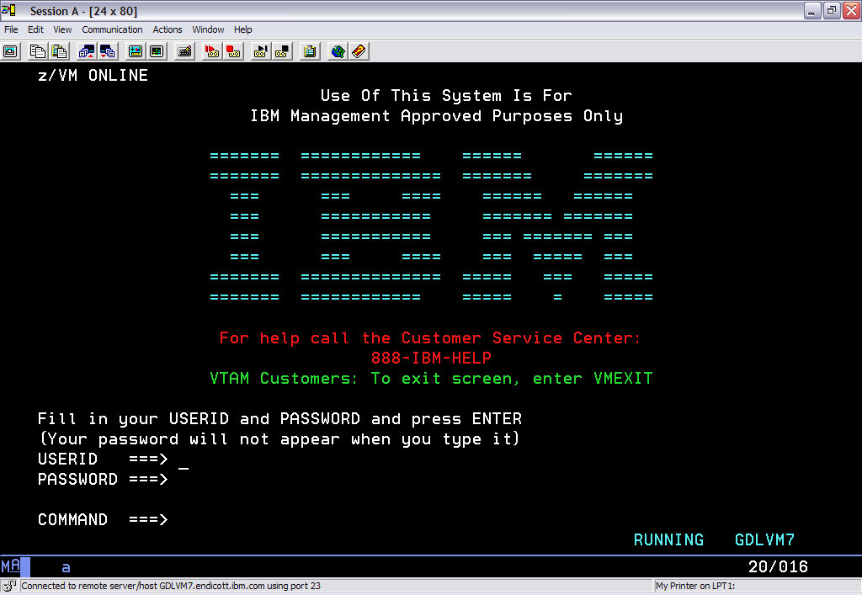
VM Logo Screen

Slide 22
Sample User Directory
USER IBMUSER IBMUSER 16M 16M G
ACCOUNT SYSTEMS
MACH XA
IPL CMS
CONSOLE 009 3215
SPOOL 00C 2540 READER *
SPOOL 00D 2540 PUNCH A
SPOOL 00E 1403 A
LINK MAINT 0190 0190 RR * CMS system disk
LINK MAINT 019E 019E RR * Product code disk
LINK 5767002P 29E 29E RR
LINK 5767002P 505 305 RR
LINK 5767002P 191 192 RR
MDISK 191 3390 1535 001 510RES MR READ WRITE MULTIPLE
Focus

Slide 23
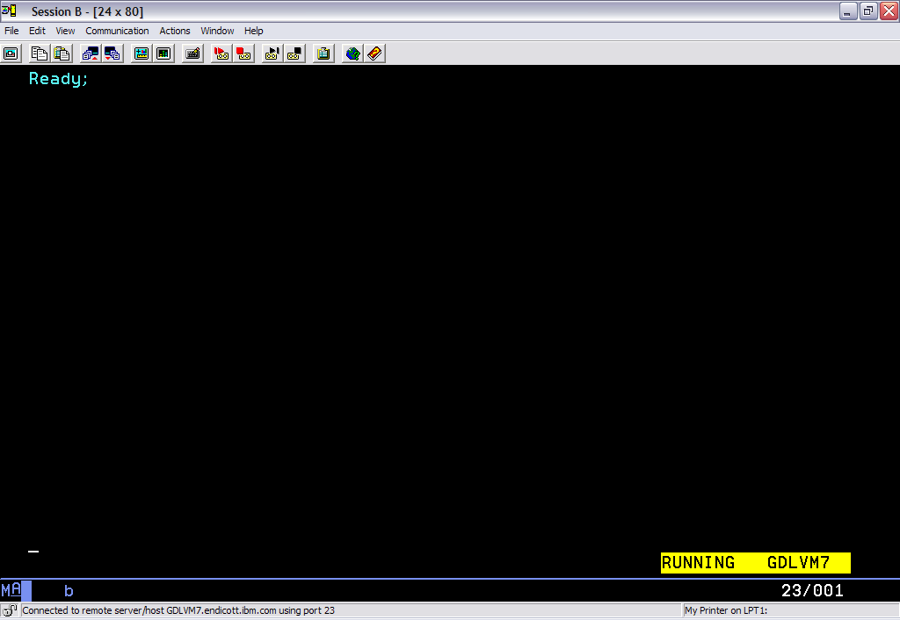
Sessions

Slide 24
IPL CMS
Ready; message indicates Initial Program Load (IPL) is complete
  CMS is initialized
  PROFILE EXEC has executed

Slide 25

Execution Modes
Status appears at the bottom right of screen
  CP Read (CP is waiting for a command)
  VM Read (CMS is waiting for a command)
  Running (Ready for cmds or working on some)
  More... (More info than can fit on the screen)
      50 seconds then beep then 10 seconds
      Determine setting: Query Term
      Page without waiting: Term More 0 0
  Holding (Waiting for you to clear the screen )
  Not Accepted (Too many commands in buffer; wait
  for executing command to complete)

Slide 26
CMS Commands
Handles a system of files: (create, modify, debug)
Many language processors/compilers can run under CMS
Commands are blank-delimited
Input accepted in ANY case
  CMS will automatically uppercase and pass to command parser
General syntax:
Command name [operand(s)...] [ (options.... [ ) ] ]
        Note: closing paren is optional
  Examples:
  copy Profile Exec A = = C
  LISTFILE ( Date
  Rdrlist

Slide 27
CMS Commands
Command Search Order
  When a command is entered, CMS has to locate it
  Search for an EXEC with the specified command name
    EXECs in storage
    Command name with Filetype EXEC on accessed disk or directory (A-Z)
  Search for translation or synonym
  Search for a module with the specified command name
    Nucleus extension, transient area, nucleus resident, on accessed disk/directory
  If Command not found in CMS, it will be passed to CP for execution (unless SET IMPCP is OFF - Implied CP)

Slide 28
SYNONYM Command
  Allows synonyms for CMS commands
  Create MYSYN SYNONYM file
    PRINT PRT 1
    RELEASE LETGO 4
    FILELIST LS 2
  enter SYNONYM MYSYN
  ABBREV function (on by default)

Slide 29
CMS Commands
Immediate Commands
  Can be entered while another command is running
  Interrupts the running command and executes immediately
  10 system immediate commands:
  HB, HI, HO, HT, HX, RT, RO, SO, TE, TS
  User's can define their own immediate commands
    IMMCMD Macro from an Assembler program
    IMMCMD Command from an EXEC
    IMMCMD option on NUCXLOAD command

Slide 30
CMS commands – finding more information
HELP command – provides assistance for:
  Commands and options
  Subcommands
  REXX statements
  Callable routines
  Pipeline stages
  Assembler language macros
  Messages
z/VM books:
  CMS Commands and Utilities Reference
  CMS Primer (tutorial)

Slide 31
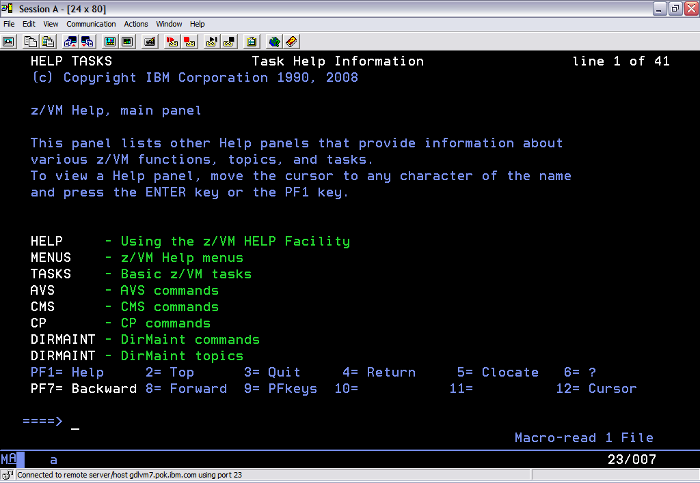
Help

Slide 32
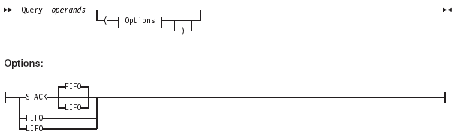
CMS Commands – syntax diagrams
HELP command and books use syntax diagrams (AKA “railroad tracks”)
  Read left to right, top to bottom
  Above the line = default value
  On the line = required (no value ON line = optional)
  Capital letters required (lowercase optional)

Slide 33
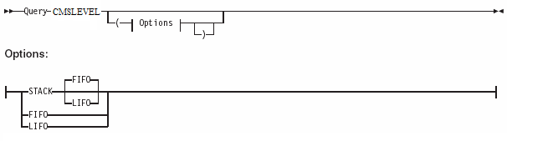
CMS Commands – syntax diagram example
Syntax diagram for QUERY CMSLEVEL
Some valid command formats:
  QUERY CMSLEVEL
  QUERY CMSLEVEL (STACK
  QUERY CMSLEVEL (STACK LIFO
  QUERY CMSLEVEL (FIFO

Slide 34
CMS Program Stack
Methods to manipulate the Program Stack:
CMS Commands:
SENTRIES, MAKEBUF, DROPBUF, DESBUF
CMS Macros:
CMSSTACK, LINERD
CSL Routines:
StackBufferCreate,StackBufferDelete, StackQuery,
StackRead, StackWrite
Pipelines:
STACK stage

Slide 35
HELP for Messages
HELP for message DMSHLP002E:
help msg dmshlp002e
help msg dms002e
help dmshlp002e
help dms002e

Slide 36
CMS File System
CMS files are unique and generally cannot be read or written by other operating systems
Files are named using a file identifier (file ID)
consisting of 3 fields:
  File name (FN) Max. 8 characters
  File type (FT) Max. 8 characters
  File mode (FM) or Directory name (dirname)
    1 letter (A-Z) where minidisk or directory resides,
    established by ACCESS command
    1 file mode number (0-6) assigned when file is created or renamed (default = 1), used to identify or operate on a subset of files

Slide 37
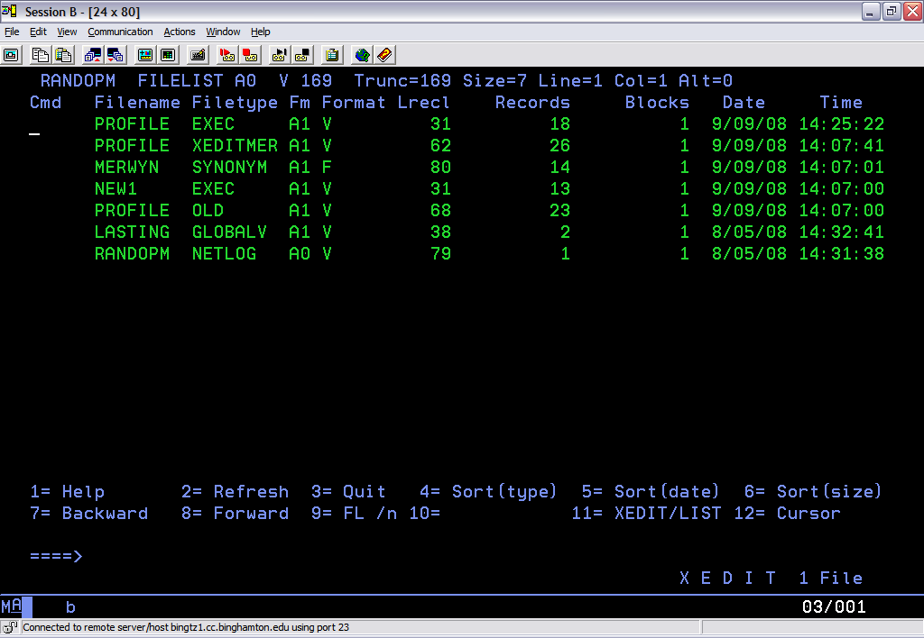
FILELIST

Slide 38
CMS File System
Files can be stored in several ways:
  On Minidisks (fn ft fm)
    Standard file modes: A - user's disk, S - system disk, Y/S - installed programs
  In an SFS (Shared File System) filespace: (GPLSRV2:CASEY.SSL.C.EXAMPLES)
  On the BFS (Byte File System) (/home/userid/...)
    hierarchical file structure
  In NFS (Network File System)

Slide 39
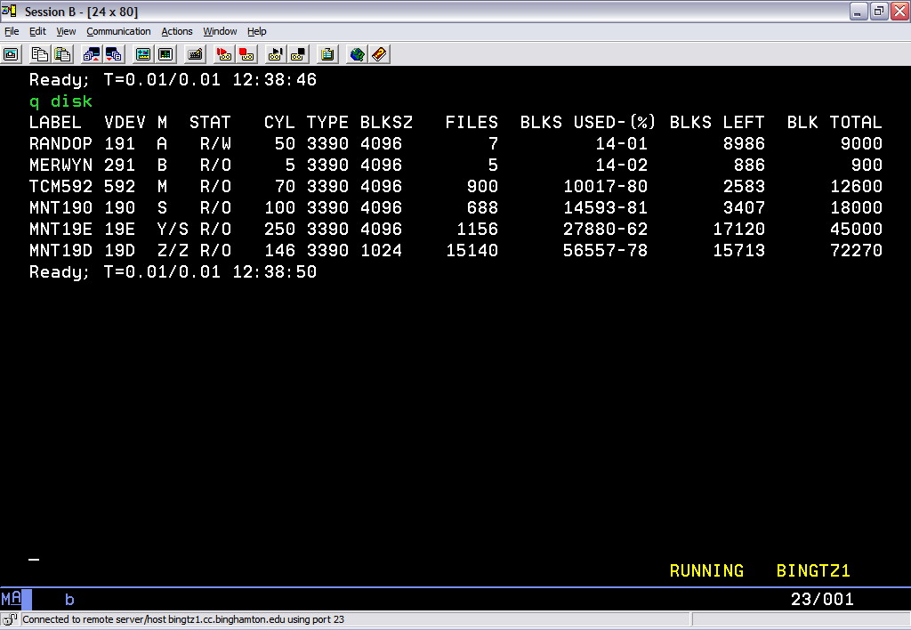
QUERY DISK

Slide 40
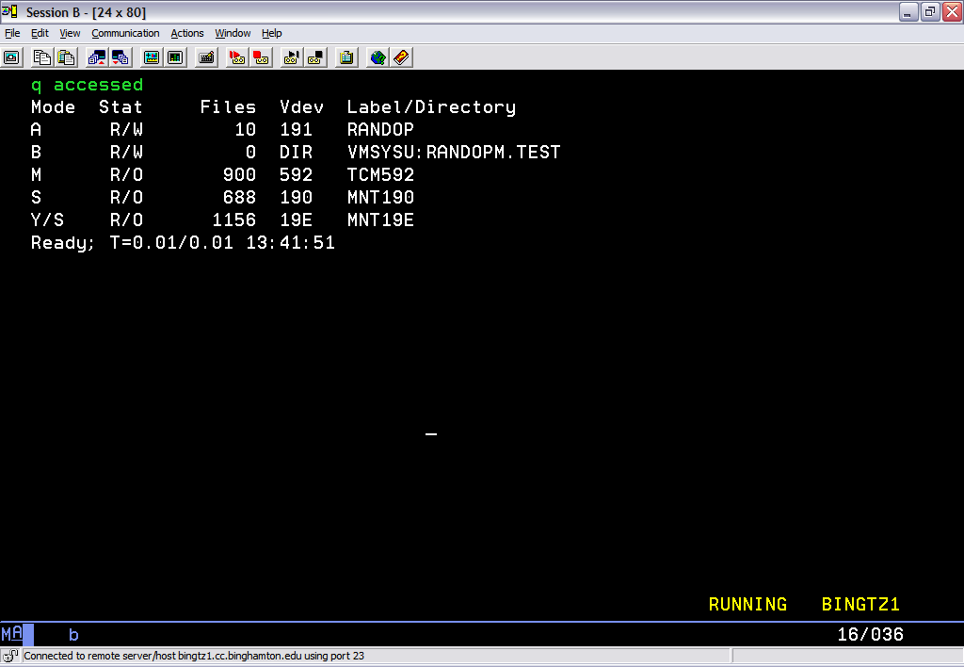
QUERY ACCESSED

Slide 41
CMS Minidisks
CMS User, Link 191 minidisk, Access as A
C
M
S
C
M
S
z/
O
S
L
I
N
U
X
L
I
N
U
X
L
I
N
U
X
A
CP
LINUX
191
Control Program
IBMUSER 191

Slide 42
Sample User Directory
USER IBMUSER IBMUSER 16M 16M G
ACCOUNT SYSTEMS
MACH XA
IPL CMS
CONSOLE 009 3215
SPOOL 00C 2540 READER *
SPOOL 00D 2540 PUNCH A
SPOOL 00E 1403 A
LINK MAINT 0190 0190 RR * CMS system disk
LINK MAINT 019E 019E RR * Product code disk
LINK 5767002P 29E 29E RR
LINK 5767002P 505 305 RR
LINK 5767002P 191 192 RR
MDISK 191 3390 1535 001 510RES MR READ WRITE MULTIPLE
Focus

Slide 43
File system - Minidisks
A location on real DASD which has been allocated for storage of a user's files
3 types of minidisks:
  Permanent
    lasts across sessions (logons); defined in directory
  Temporary (T-disks)
    are destroyed at logoff
    use CP DEFINE command or attach by operator
  Virtual disks in storage (V-disks)
    temporary simulations of minidisks in system storage
    not allocated on real DASD; avoids I/O overhead

Slide 44
File system - Disk Commands
CP DEFINE, CP LINK, CMS ACCESS
  Defines a virtual device or virtual disk in storage
  -- DEFINE t3380 as 991 cyl 10
  Link to other user's minidisks to share files
  -- LINK caseyct 191 991 rr
  Once linked, a disk can be accessed
  -- ACCESS 991 c
FORMAT
  Minidisks must be formatted before using the first time
  -- FORMAT 991 c

Slide 45
Disk Commands (cont.)...
RELEASE, CP DETACH
  Release frees an accessed disk
  -- Release c
  Detach removes the device from your VM configuration
  -- Detach 291 -or- Release c (detach
CP QUERY DASD
  Shows what you have linked; displays status
Q ACCESSED, Q DISK, Q SEARCH
  Shows various status information for accessed disks/directories
LISTFILE, FILELIST
  Lists the files on an accessed minidisk or directory

Slide 46
Developing Programs
Creating and Compiling
  Use XEDIT to create the program like any other file
  Filetype indicates name of programming language
  you are using
    Assemble, Fortran, C, Cobol, PLI, etc.
  Invoke the compiler by typing compiler name followed
  by File name of the program
  LISTING and TEXT files are produced
  example: ASSEMBLE ASM1 result: ASM1 LISTING
  ASM1 TEXT

Slide 47
XEDIT
Command: Xedit fn ft fm
Each line is a record
Screen Layout:
TEST FILE A1 F 80 Trunc=80 Size=45 Line=0 Col=1 Alt=0
===== * * * Top of File * * *
|...+....1....+....2....+....3....+....4....+....5....+....6....+....7...
===== one
===== two
===== three
===== four
===== five
===== six
===== seven
===== eight
===== nine
===== ten
====>
X E D I T 1 File
Current Line
Scale
Data Area
Prefix Area
Command Line

Slide 48
XEDIT
Prefix Commands (subset)
    m, mm mm - move
    c, cc cc - copy
    f - following
    p - preceding
    a - add
    si - sequential insert
    d, dd dd - delete
    ","" "" - repeat

Slide 49
XEDIT
Command: Xedit fn ft fm
Each line is a record
Screen Layout:
TEST FILE A1 F 80 Trunc=80 Size=45 Line=0 Col=1 Alt=0
===== * * * Top of File * * *
|...+....1....+....2....+....3....+....4....+....5....+....6....+....7...
===== one
===== two
=mm= three
===== four
=mm= five
===== six
===== seven
===== eight
===== nine
=f=== ten
====>
X E D I T 1 File
Current Line
Scale
Data Area
Prefix Area
Command Line

Slide 50
XEDIT
Command line commands
  screen format
  change /xxx/yyy/ * *
  /zzz/ (find zzz in text)
  all /zzz/ (find all zzz at once)
Ending
  Quit – Prompt asking if really want to quit
  QQuit – leave and doesn’t save changes
  SAVE - doesn't leave, but does save changes
  FILE - leave and save changes

Slide 51
XEDIT
Write your own command
  Name: yourcmdn XEDIT
  Write using REXX
  Use: EXTRACT to get session information
  Can use Pipelines

Slide 52
XEDIT
Default Program Function Keys
      PF1 BEFORE HELP MENU
      PF2 BEFORE SOS LINEADD
      PF3 BEFORE QUIT
      PF4 BEFORE TABKEY
      PF5 BEFORE SCHANGE 6
      PF6 ONLY ?
      PF7 BEFORE BACKWARD
      PF8 BEFORE FORWARD
      PF9 ONLY =
      PF10 BEFORE RGTLEFT
      PF11 BEFORE SPLTJOIN
      PF12 BEFORE CURSOR HOME

Slide 53
XEDIT
PROFILE XEDIT runs when XEDIT is invoked
Sample: PROFILE XEDIT
/* PROFILE XEDIT */
'SET VERIFY OFF 1 72'
'SET NUMBER ON'
'SET PREFIX NULL'
'SET CASE MIXED IGNORE'
'SET CURLINE ON 4'
'SET SCALE OFF'
'SET AUTOSAVE 1'
Note: Xedit is very tailorable !

Slide 54
XEDIT
New Screen Layout
TEST FILE A1 F 80 Trunc=80 Size=45 Line=0 Col=1 Alt=0
0 * * * Top of File * * *
1 one
2 two
3 three
4 four
5 five
6 six
7 seven
8 eight
9 nine
10 ten
11 eleven
12
13
14
15
16
17
====>
X E D I T 1 File
Current Line
Scale
Prefix Area
is
GONE
Data Area
Command Line

Slide 55
EXECs
Types: EXEC, EXEC2, and REXX
REXX
  /* starts with a comment */
  Contains Variables and Stemmed Arrays
    Stores Strings and Numbers as strings
  Has 'flow control'
      do and do while
      if then else
      select
      interpret
  Allows Functions and Procedures
  Issues CP/CMS commands (in quotes)

Slide 56
EXECs
PROFILE EXEC runs when you sign on
HUGENBRU SYNONYM A
/* Profile Exec Sample */
'SYNONYM HUGENBRU SYNONYM A'
'CP SPOOL CONS * START'
'CP TRACE END'
'CP SET MSG ON'
'CP SET PF12 RET'
* * * Top of File * * *
RECEIVE REC 3 * * * End of File * * *

Slide 57
Pipelines
CMS command
Several Programs (stages) pass records
Many sources for data
  commands
  xedit
  disks
  storage, etc.
Example:
'pipe ',
'| < my data a',
'| locate /my line/',
'| > mynew data a'

Slide 58
CMS
Operating System
Provides an interactive user environment
Allows application development and execution
Easy to customize
  User Environment
  Commands
  Xedit environment

Slide 59
References
VM Library
  http://www.vm.ibm.com/library
HELP Facility
  HELP command
  HELP msg DMSxxxE
  CP Link MAINT 19D 19D rr
    link for HELP disk

